Slide 1

3D Infinite Runner Game
Run & Gun
Fahim Kamal Ahmed
Batch: CSE 10th
Dept. of Computer Science & Engineering
Pundra University of Science & Technology

Slide 2
Overview
Introduction
Motivations
Features
Tools & Technologies
Project Design and Concept (Run & Gun)
Player Control
Basic Gameplay(Running)
Basic Gameplay(Shooting)
Gameplay Mechanics
User Interface
Other Features
Project Sketch
Conclusion

Slide 3
Introduction
A video game is a graphical application in real time where there is an explicit interaction between the user and the video game.
The first video game “SpaceWar” was created in 1960s by a college student.
The video game industry is a rapid-growing market that went from having a market volume of $4 billion in 1990 to 159.3 billion in 2020.
85% of industry revenue comes from free to play games.
Video games have been an important concept in the advancement of technology for over 30 years now.
But in our country people seems to quite ignorant about this industry.

Slide 4
Motivations
I love to play games myself. So now I want to use my skills to built a career on it as game developer.
Day by day the popularity of video games is increasing as wildfire. The game creators are earring in billions.
Because of that new job opportunities is increasing everyday in our country in this field.
Because of the lack of professionals in the field, competition in job sector is quite less in this field.
Programming, 3D modeling is not only needed in games but in other sectors as well. Which means, there are other great high paying jobs opportunities out there besides this sector.

Slide 5
Features
The game is a 3D game.
The player will experience the game in 3rd person perspective view.
The game has two modes: Runner mode and Shooter mode.
The game has dynamic real time Map generation system.
NPC or Enemy AI is implemented in Shooter mode of the game.
Difficulty level of game will increase as player progresses in game.
Each time the experience of the game will be different.

Slide 6
Tools & Technologies
Programming Language
Software
C#
Unity Game Engine
Microsoft Visual Studio
Blender 3D

Slide 7
Project Design and Concept
Player Control |  | You control a | in this
 |  | where | Makes the player
Human
3rd Person | game
A, W, S, D, Left mouse
Move left, right, jump, slide, Shoot

Slide 8
Project Design and Concept (Cont..)
Basic Gameplay (Runner Mode) |  | During the game | from
 |  | and the goal of the game is to | Makes the player
Tree, rock | appear
Top of the screen
Go as far as possible avoiding those obstacles and collect coins.

Slide 9
Project Design and Concept (Cont..)
Basic Gameplay (Shooter Mode) |  | During the game | from
 |  | and the goal of the game is to | Makes the player
Enemies | appear
Different part of the screen
Shoot those enemies before they shoot the player and kill him.

Slide 10
Project Design and Concept (Cont..)
Gameplay Mechanics |  | As the game progresses | making it
 |  | [optional] There will also be | Makes the player
Run speed will increase and enemies will be more aggressive.
Difficult for player to continue playing.
Extra lives, Shield powerup, Magnet powerup.

Slide 11
Project Design and Concept (Cont..)
User Interface |  | The | will | whenever
 |  | At the start of the game, the title |  | and the game will end when
Coins, lives & timer
Increase & decrease
Enemies are killed Coins will increase. Lives will decrease as enemies shoots the player.
Run & Gun | will appear
Player loses all his lives.

Slide 12
Project Design and Concept (Cont..)
Other Features
#1 Buy and unlock different player skins with coins. #2 Buy and unlock different playable environments with coins. #3 Buy and unlock different weapons with coins.

Slide 13
Project Sketch (Endless Run Area)
Tree
Rock
Obstacles to avoid
Endless background
Scroll
Rock
Player
Character will run forward with constant speed.
Player will control left and right movement.

Slide 14
Project Sketch (Shooting Area)
Enemy
Enemies trying
to shoot the player
Endless background
Scroll
Enemy cover
Player
Character will run forward with constant speed.

Slide 15
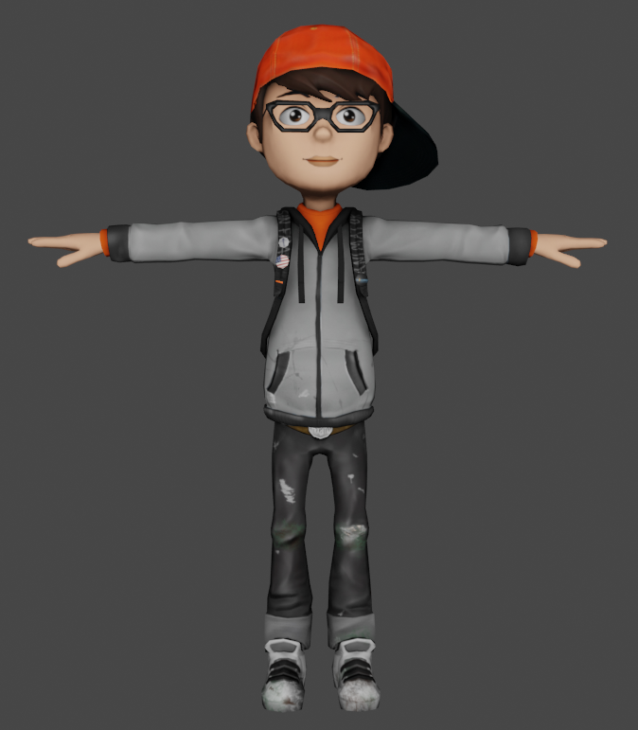
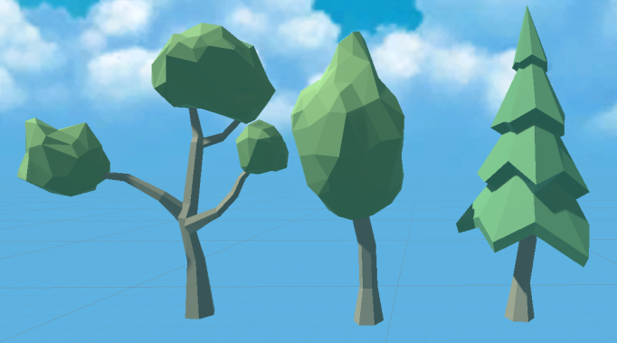
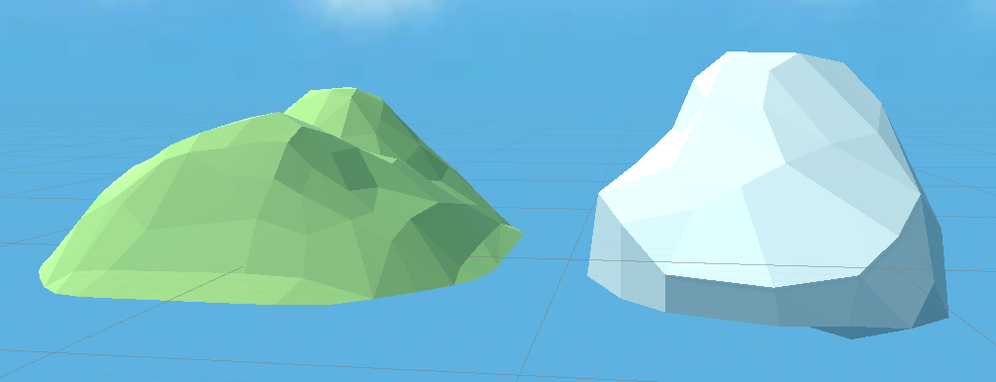
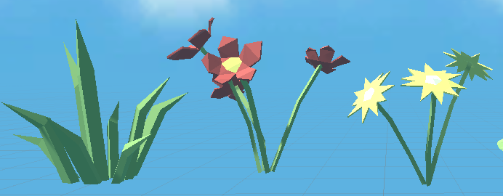
System Implementation (3D Assets)

Slide 16
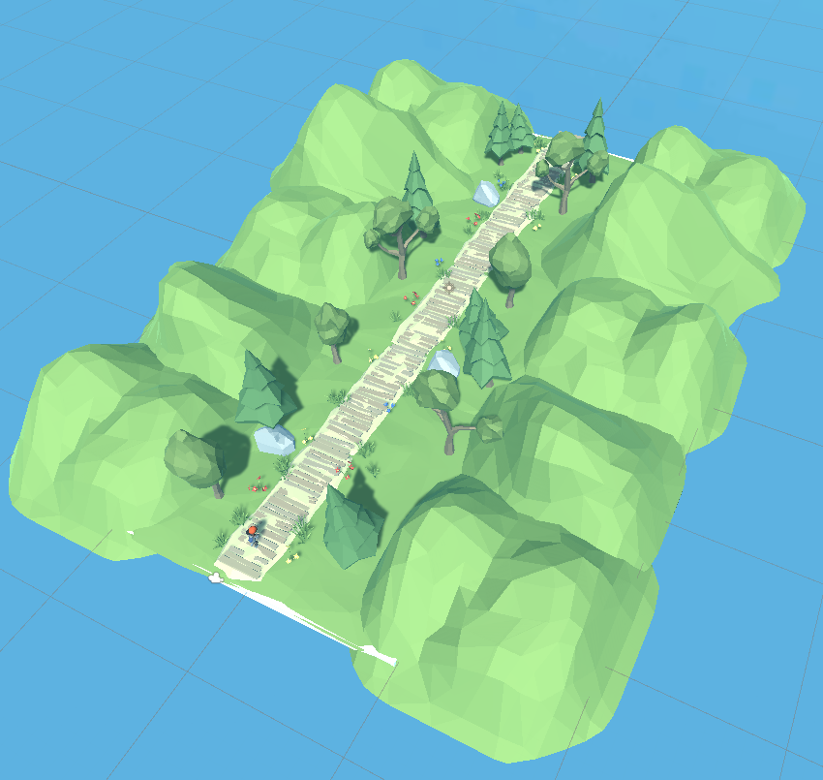
System Implementation (Level Design)

Slide 17
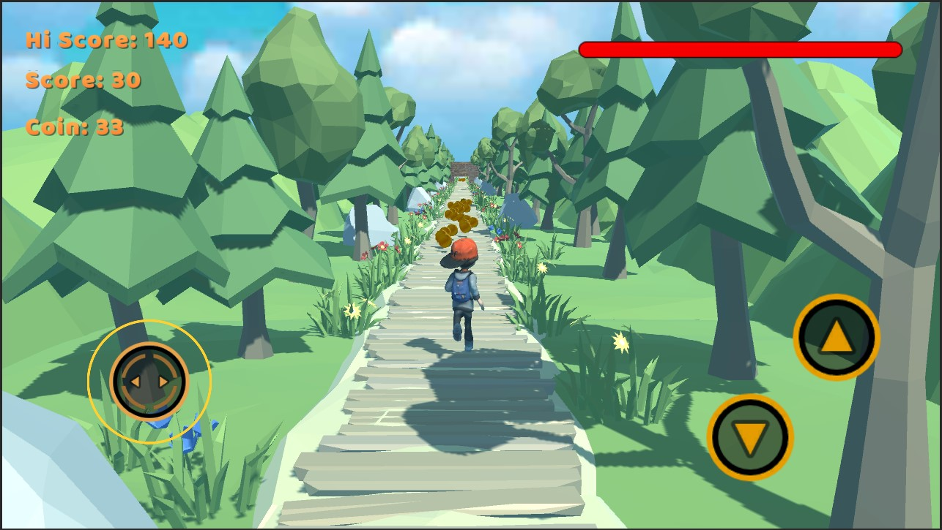
Game view (Runner Mode)

Slide 18
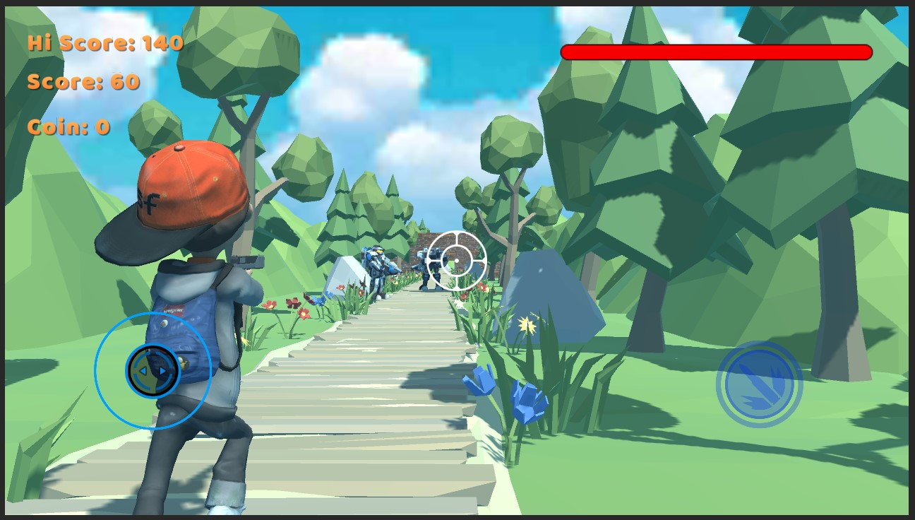
Game view (Shooter Mode)

Slide 19

Download Link

Slide 20
Conclusion
So far the past 6 months has been quite challenging for me but I’m grateful to Almighty Allah and my supervisor that I have completed my project.
I am proud and confident about my work as I have already been awarded Second Position for my Game in “PUB Spring Fest 22-Project Showcase”. Everyone loved my game and inspired me to do more.
I’m hopeful about the future and my dream career as a game developer. I hope the final product of my project will attract both game lovers and potential employers who will be interested in hiring me to work for them and create more beautiful games like this.

Slide 21
Thank you

